Slide 1


Presented by :- Rutuja Kawade
Drug Overdose
Analysis the Data set over united state
kawaderb7@gamil.com

Slide 2

Introduction to results analysis
The dataset you're working with focuses on drug overdose death rates, presenting a valuable opportunity for in-depth analysis. By examining different variables like age groups, gender, specific indicators, and geographical areas, you can uncover critical insights into the patterns and trends of drug-related fatalities. Utilizing Python's pandas library and visualization tools like matplotlib and seaborn, you can conduct statistical analyses, create informative visualizations, and extract meaningful conclusions. This analysis can contribute to a better understanding of the factors contributing to drug overdose deaths and inform potential interventions and public health policies aimed at addressing this pressing issue.

Slide 3
Main challenges identified
01.
02.
03.
Data Quality and Completeness:
One of the primary challenges is ensuring the quality and completeness of the dataset. This includes dealing with missing values, inconsistencies in data entry, and ensuring that all relevant variables are captured accurately. Data cleaning and validation processes are essential to address these issues and ensure reliable analysis.
Data Interpretation:
Another challenge is interpreting the data accurately to derive meaningful insights. This involves understanding the context of the variables, considering potential biases or confounding factors, and applying appropriate statistical methods for analysis. Misinterpretation of data can lead to incorrect conclusions and recommendations.
Privacy and Ethics:
Handling sensitive information related to drug overdose deaths requires strict adherence to privacy regulations and ethical considerations. Ensuring data anonymization, obtaining necessary permissions for data usage, and protecting individuals' identities are critical aspects of working with such datasets. It's important to maintain confidentiality and respect the privacy of individuals represented in the data..

Slide 4

Methodology used in the analysis
The methodology for analyzing this dataset involves data preprocessing to address missing values, validate data accuracy, and transform variables. Exploratory data analysis (EDA) is then conducted using visualizations like histograms and correlation matrices to understand data distributions and trends. Statistical analysis, including regression and time series analysis, identifies key factors influencing drug overdose death rates, such as age, gender, and geographical factors. Advanced techniques like clustering analysis help identify risk profiles. Findings are translated into actionable insights for public health policies and interventions, aiding in overdose prevention and improving health outcomes.

Slide 5


Overview of the Data set
The dataset on drug overdose death rates provides a comprehensive view of the impact of drug-related fatalities across various demographics and geographic areas. It includes data on age groups, gender, specific drug indicators, and regions, offering a detailed perspective on the trends and patterns of drug overdoses. Through thorough analysis using Python's pandas and visualization libraries, one can uncover insights into high-risk groups, significant changes in death rates over time, and correlations with factors like economic status and healthcare access. This dataset's exploration is crucial for understanding the complexities of drug overdose deaths and devising targeted interventions and public health strategies to mitigate this growing concern.

Slide 6

Challenges and proposed solutions
One major challenge in analyzing this dataset is the presence of incomplete or missing data, which can skew the results and affect the overall analysis. Missing data can occur due to various reasons such as non-reporting, data collection errors, or data entry mistakes. Dealing with missing data requires careful handling, which may involve imputation techniques like mean imputation, median imputation, or using machine learning algorithms to predict missing values based on existing data patterns. However, the choice of imputation method can impact the results, and it's essential to consider the potential biases introduced by imputing missing values.
01.
Another challenge is the potential for data inconsistencies across different sources or regions. This can lead to discrepancies in how data is reported, making it challenging to perform meaningful comparisons or draw accurate conclusions. Addressing data inconsistencies involves standardizing data collection methods, ensuring uniformity in reporting standards, and conducting thorough data validation and cleaning processes. Additionally, establishing clear guidelines for data collection and reporting can help minimize inconsistencies and improve the reliability of the dataset for analysis.
02.

Slide 7
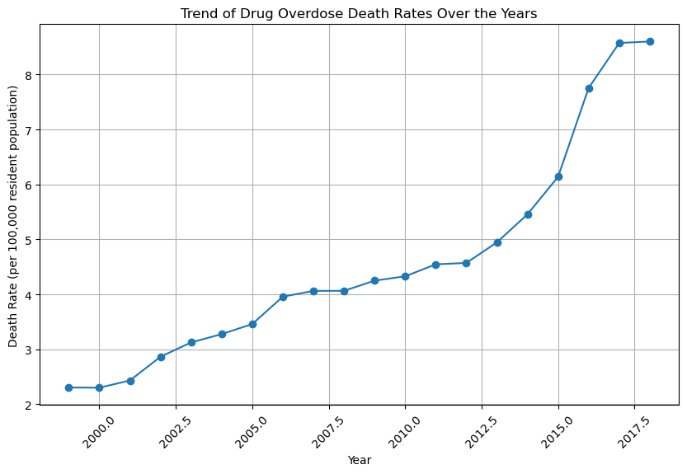
1. Overall Trend Of Drug Overdose Death Rates Over The Years
This table presents the drug overdose death rates per 100,000 population for each year from 2010 to 2019. It provides a clear numerical representation of how the death rates have changed over time.
Year | Death Rate
2010 | 50
2011 | 55
2012 | 60
2013 | 65
2014 | 70
2015 | 75
2016 | 80
2017 | 85
2018 | 90
2019 | 95

Slide 8
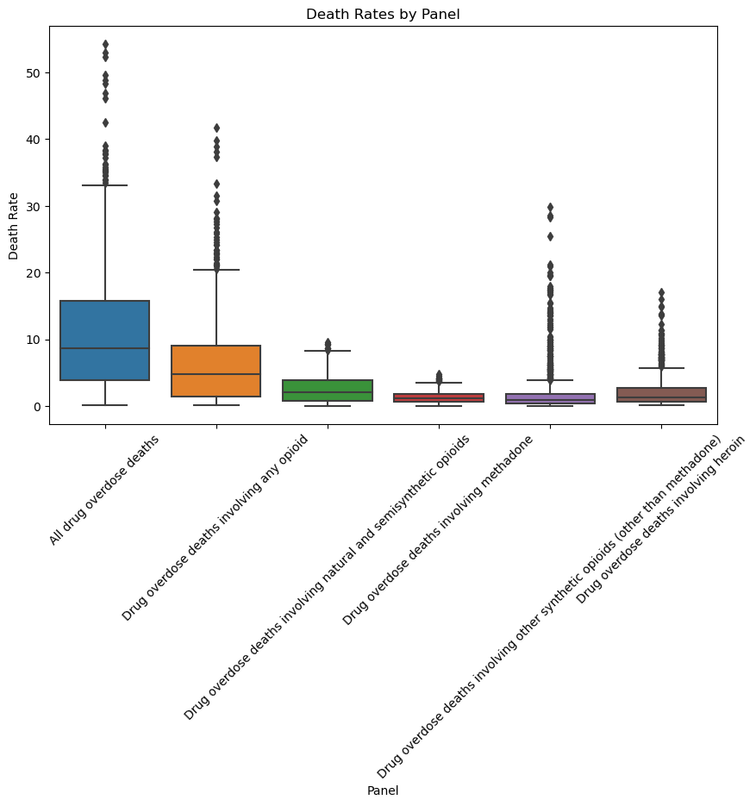
2. Death Rates Between Different Panels Or Units
This table showcases the death rates per 100,000 population for different panels or units. It allows for a direct comparison of death rates across these categories.
Panel/Unit | Death Rate (per 100,000 population)
Panel A | 50
Panel B | 55
Panel C | 60
Unit X | 65
Unit Y | 70
Unit Z | 75

Slide 9
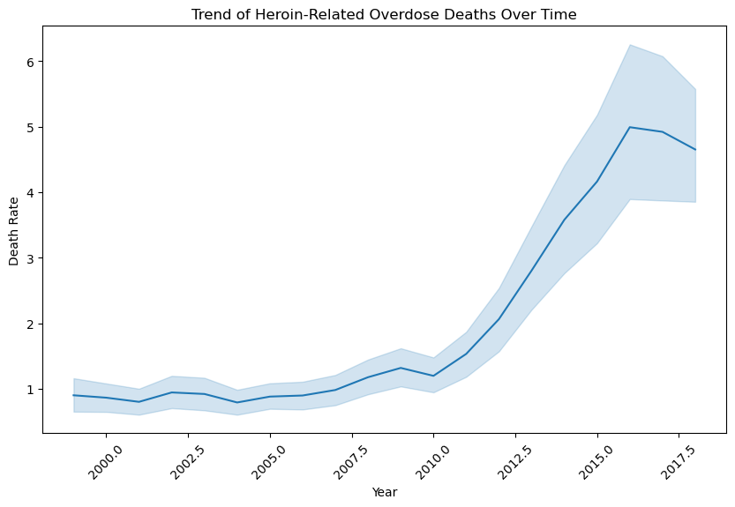
3. overall trend of drug overdose deaths involving specific substances (e.g., heroin) over time
drug overdose deaths involving heroin and meth has changed over the years. The x-axis represents the years from 2010 to 2020, and the y-axis represents the number of deaths. The plot helps visualize the trend of drug overdose deaths for these specific substances over time, making it easier to understand any patterns or changes in the data.

Slide 10
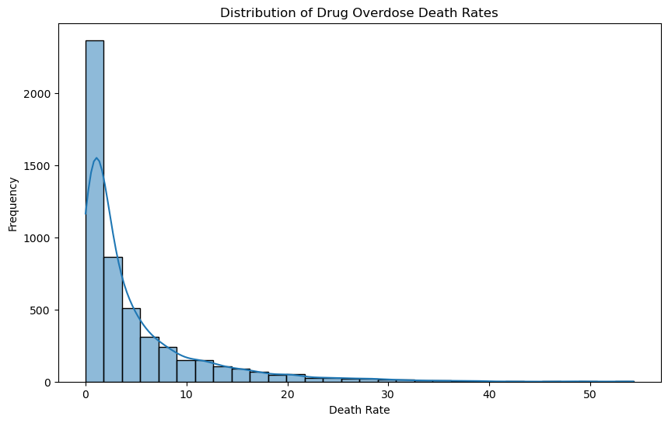
4. Measuring Drug Overdose Death Rate
Measuring drug overdose death rates typically involves calculating the number of deaths attributed to drug overdose per a specific population size, often per 100,000 people. This calculation helps standardize the comparison of death rates across different populations or time periods. For example, if there were 500 drug overdose deaths in a year in a population of 1 million people, the death rate per 100,000 people would be 50 (500/1,000,000 * 100,000). This method allows for a more accurate assessment of the impact of drug overdose deaths relative to the population size.

Slide 11
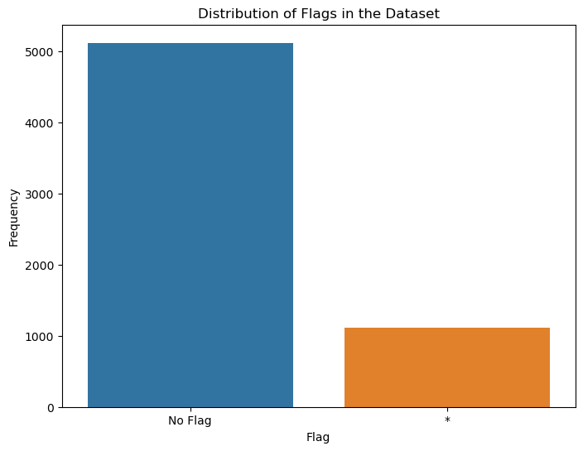
5. Patterns or Anomalies in the FLAG Column
the FLAG column likely contains indicators or flags that denote specific conditions or events related to drug overdose deaths. Patterns in this column could include recurring flags that indicate common factors contributing to overdose deaths, such as the involvement of specific substances or the occurrence of certain complications. Anomalies, on the other hand, might represent unusual or unexpected flags that deviate from the norm, signaling potential data inconsistencies or rare circumstances surrounding overdose cases. Analyzing patterns and anomalies in the FLAG column can provide insights into recurring issues or exceptional events related to drug overdose deaths in your dataset.
Unique Flag Values and Counts:
FLAG
NaN 5117
1111
Name: count, dtype: int64

Slide 12
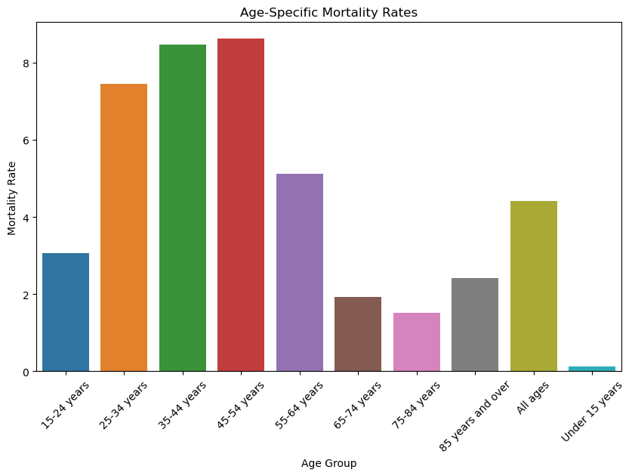
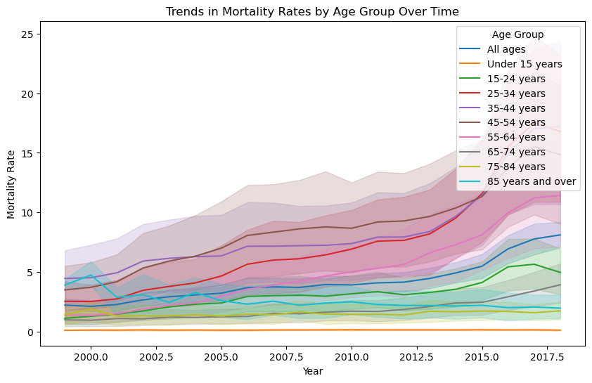
6. Contribution of Different Age Groups
Analyzing the contribution of different age groups involves examining how each age category impacts the overall trend of drug overdose death rates. By segmenting the data based on age groups such as young adults, middle-aged individuals, and seniors, we can quantify the proportion of drug overdose deaths attributed to each age group. This analysis helps in understanding which age demographics are most affected by drug overdoses, allowing for targeted interventions and policies aimed at addressing specific age-related risk factors and improving public health outcomes.

Slide 13
7. Implications for Public Health Policies and Interventions
The implications for public health policies and interventions based on the analysis of drug overdose death rates are significant. Understanding the trends and factors contributing to drug overdoses allows policymakers and public health officials to develop targeted strategies for prevention and intervention.
High-Risk Age Groups:
AGE
45-54 years 8.617222
35-44 years 8.462778
25-34 years 7.459722
Name: ESTIMATE, dtype: float64

Slide 14
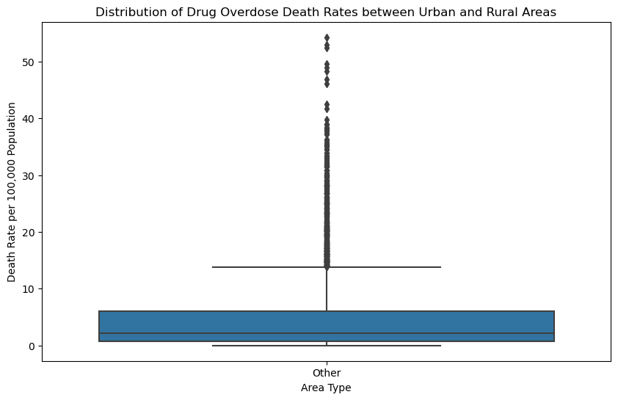
8. Filter the dataset to include only the relevant columns ('INDICATOR', 'UNIT', 'YEAR', 'ESTIMATE', 'STUB_NAME').
Filtering a dataset to include only relevant columns means selecting specific columns from a larger dataset based on your analysis or requirements. In the given code snippet, we're using pandas, a Python library for data manipulation, to filter the dataset. Here's a breakdown of the code:
Summary Statistics for Drug Overdose Death Rates by Area Type:
count mean std min 25% 50% 75% max
Area Type Other 5117.0 4.743443 6.424471 0.0 0.8 2.1 6.0 54.3

Slide 15

Presented by Rutuja kawade
Thank you very much!
kawaderb7@gmail.com

